Slide 1
DetectGPT: Zero-Shot Machine-Generated Text Detection using Probability Curvature
Submitted By:
Sabbir Bin Abdul Latif
Student ID: 23341067
Section: 01
Group: 12
Submitted To:
Annajiat Alim Rasel
Senior Lecturer, Department of CSE
BRAC University
RA: Adib Muhammad Amit
ST: Farah Binta Haque

Slide 2

Introduction to DetectGPT
Overview of increasing usage of LLMs like GPT-3, PaLM, and ChatGPT.
Challenges in detecting LLM-generated text.
DetectGPT: A zero-shot detection method using probability curvature.

Slide 3
The Challenge of Detecting LLM-Generated Text
Fluency
Difficulty
Reliable
LLMs' fluency in generating texts on various topics.
Difficulty in distinguishing between human-written and LLM-generated texts.
The necessity for reliable detection methods.

Slide 4
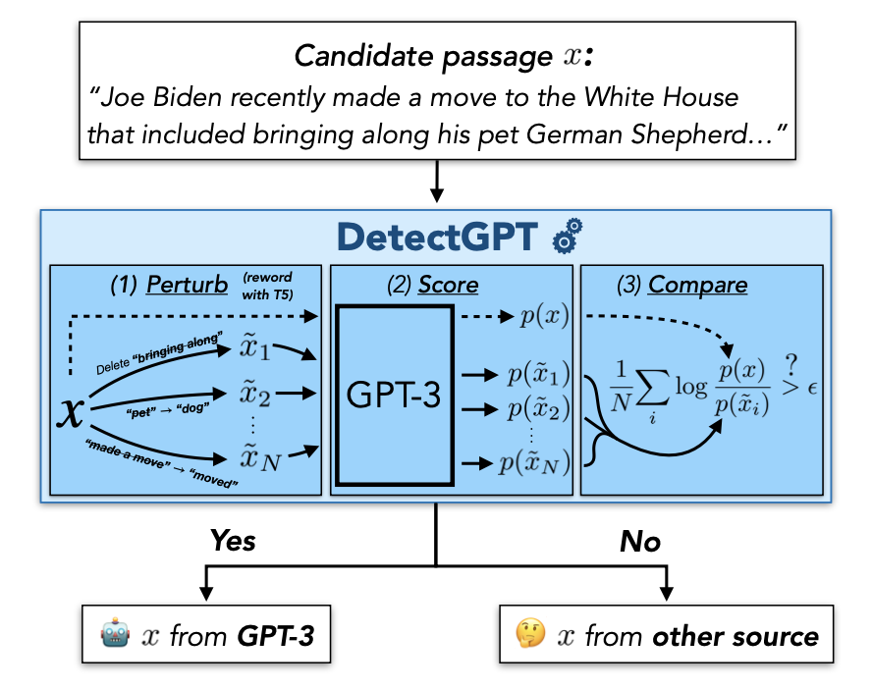
Understanding DetectGPT's Core Mechanism
Text from LLMs tends to occupy negative curvature regions in the model’s probability function.
DetectGPT’s approach using log probabilities and random perturbations.
Advantages over existing methods: no separate classifier or dataset is needed.

Slide 5
DetectGPT Methodology
→ Process of minor perturbations using another pre-trained model (e.g., T5).
→ Comparison of log probabilities between original and perturbed samples.
→ Algorithmic steps involved in DetectGPT.

Slide 6
DetectGPT Methodology
→ Process of minor perturbations using another pre-trained model (e.g., T5).
→ Comparison of log probabilities between original and perturbed samples.
→ Algorithmic steps involved in DetectGPT.

Slide 7
DetectGPT Methodology
→ Process of minor perturbations using another pre-trained model (e.g., T5).
→ Comparison of log probabilities between original and perturbed samples.
→ Algorithmic steps involved in DetectGPT.

Slide 8
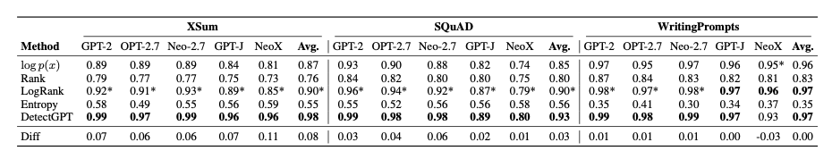
Experimental Results and Efficacy
Result
Case studies
Analysis
Improvement in detection accuracy over existing zero-shot methods.
Fake news articles and large parameter models like GPT-NeoX.
Statistical analysis showcasing DetectGPT's superiority.

Slide 9
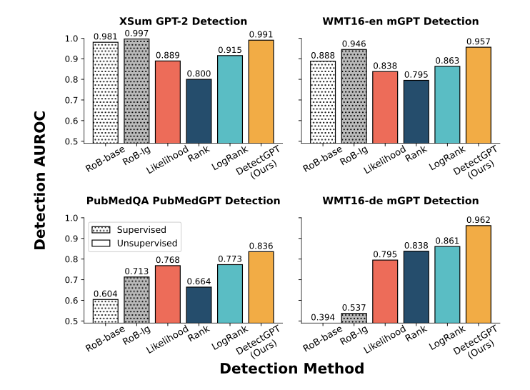
Key Contributions of DetectGPT
→ Novel approach in machine-generated text detection.
→ Effective utilization of probability curvature for detection.
→ Practical implications and potential applications.

Slide 10
Future Directions and Conclusion
Improvements
Potential improvements and expansions of DetectGPT.
Impact
Broader impact on the field of text generation and detection.
Remarks
Concluding remarks on the importance of such detection tools.

Slide 11
Thanks!

